Slide 1
Fragment ?

Slide 2
What is a Fragment?
Activity 1
Activity 2
Before android 3.0 ,
If you have to show View 3 and View 4 you have to create new activity
View 1
View 3
View 2
View 4

Slide 3
What is a Fragment?
Now, just insert fragment or delete it and insert another fragment.
Fragments are so much customizable.
View 1
View 3
View 2
View 4
Fragment 1
Fragment 2
Activity 1
Activity 1

Slide 4
What is a Fragment?
ACTIVITY
Fragment is a chunk of UI.
It has its own Lifecycle.
It can process its own events
It can be added or removed while the Activity runs.
It was introduced in Honeycomb API 11.
You can use Fragments on older devices using a Support Library from 1.6 to 2.3
FRAGMENT 1
FRAGMENT 2
ListView
ImageView

Slide 5
Why do you need Fragments ?
Combine Several Fragments in One Activity
Reuse the same Fragment across several Activity
Make better use of larger screen space on tablets

Slide 6
How to make a Fragment ?
Create new Blank Fragment
It will create a java and a xml file.
The XML will be responsible for Front End.
The Java File will be responsible for Backend.

Slide 7
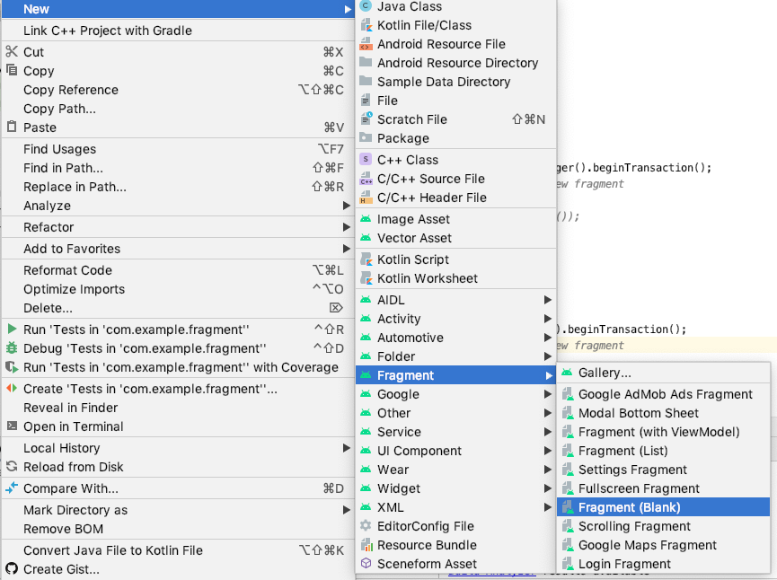
Create 2 Blank Fragments.
Frag1
Frag2

Slide 8
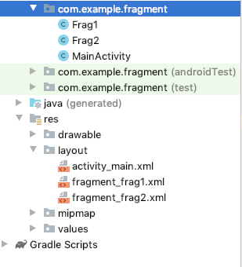
Project Structure

Slide 9
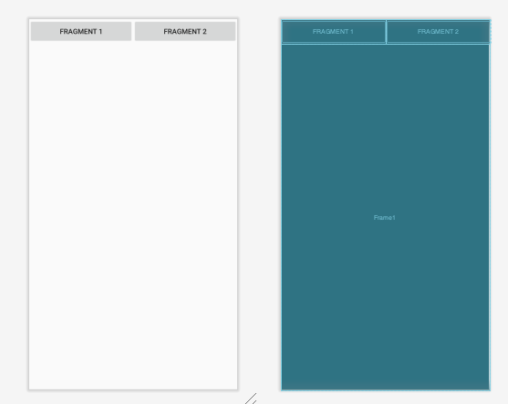
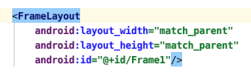
Activity_main.xml

Slide 10
Fragment Transactions
Fragement
Manager
Changes to the UI in terms of adding,
Removing and replacing Fragments are
Conducted as FragmentTransactions
Begin a transaction
Add, remove, replace whatever fragments you want
Commit the transaction
Fragement A
begin
commit

Slide 11
To change Fragment
FragmentTransaction ft = getSupportFragmentManager().beginTransaction();
// Replace the contents of the container with the new fragment ft.replace(R.id.Frame1, new Frag2()); // or add
ft.add(R.id.Frame_id, new FragmentClassName());
// Complete the changes added above ft.commit();

Slide 12
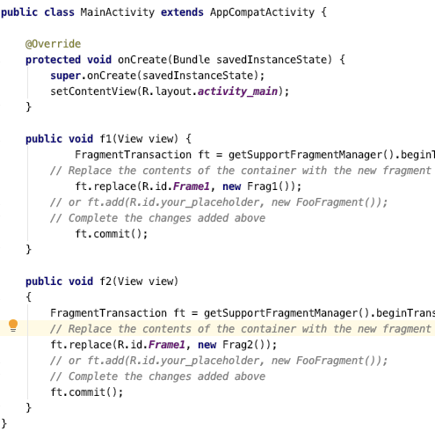
Activity_main.java

Slide 13
Inter-Fragment communication design
Don’t maintain direct references of fragments within each other
Crete an interface that contains the method which will act as an event carrier
Let the Activity implement the interface
Let Fragment 1 use the interface to send messages
Use the callback method in Activity to trigger changes in Fragment 2
interface
FragmentManager
Activity
Fragment 1
Fragment 2

Slide 14
Questions ?

